Slide 1
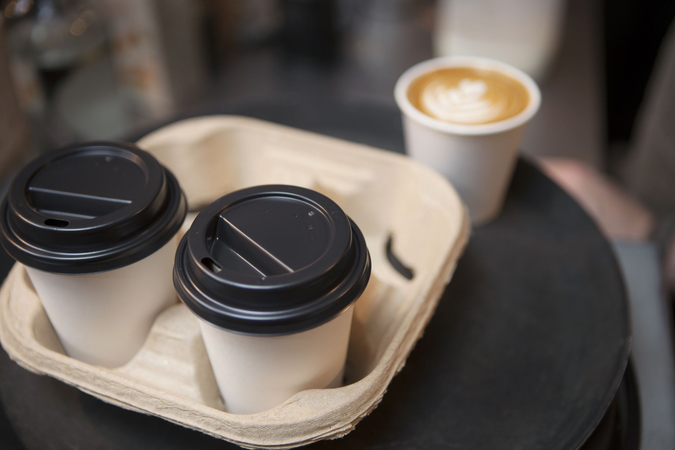
Bright Coffee Shop
Sales Analysis Business Performance
January – June 2023 | Three New York store locations
Prepared by Lukhanyo Vunjana
Notes:
Introduce the project: an analysis of six months of sales across three stores.

Slide 2
Business Objective
The objective of this analysis is to evaluate Bright Coffee Shop's historical sales data to identify revenue opportunities, understand sales performance and support data-driven business decisions.
Identify Top-Performing products: Determine which products generate the highest revenue and contribute most to overall sales
Analysis Sales by Time of Day: Identify peak sales period to understand customer purchasing patterns and optimize operations.
Evaluate Sales Trends: Examine sales performance across products, days, months, and time intervals to identify trends and areas for improvement
Provide Actionable Recommendations: Develop data-driven strategies to increase revenue, improve product performance, and support sustainable business growth

Slide 3



Dataset & Methodology
Dataset Overview:
Daily transactional sales data used to investigate revenue, products, and purchasing patterns
Data Preparation:Data quality checks, format verification and preparation for analysis
Tools:
: Used for data preparation and preliminary analysis
: Used to write SQL queries, filtering, grouping, data aggregation, and trend analysis
:Used it to build interactive dashboards and data visualization
Analysis:
Product revenue, peak sales periods and trends over time

Slide 4
Overview
$698.8K
149,116
147,388
$4.69
Total revenue
Products sold
Transactions
Avg. revenue per product
The three stores perform almost identically; Hell's Kitchen is slightly ahead.
29 product types across 9 product categories, grouped by revenue, store, month, weekday and time of day
Revenue grew about 104% from January ($81.7K) to June ($166.5K).
Coffee ($270K) and Tea ($196K) make up two thirds of revenue.
Afternoon is the strongest time of day ($245K); evening the weakest ($66K). $0 $25K $50K $75K
Weekday sales are very even — about $97K $102K per day.

Slide 5
INTERACTIVE SALES DASHBOARD
Notes:
Walk through the dashboard: filters, KPIs and what stakeholders can explore.

Slide 6
Coffee and tea drive two-thirds of revenue
Revenue by product category ($K) Top 5 products
66.7% of revenue comes from Coffee (38.6%) and Tea (28.1%) combined, driven by Barista Espresso being the single best-selling product type, 13% of total revenue across all stores, months and times of the day

Slide 7
All three stores perform almost equally
Hell's kitchen leads by only 2.8% over Lower Manhattan
Lower Manhattan sells the most Branded items ($6.2k)
Hell's kitchen leads in Coffee beans ($18.6)
Coffee is the biggest revenue generator in all store

Slide 8
Afternoons lead; weekdays are steady
Revenue by time of day and by day of week ($K)
Afternoon is the busiest period (35% of revenue – driven by Barista Espresso) ; evening is the quietest (9%). Daily sales are almost flat, with Saturday slightly lowest.

Slide 9
Sales doubled from January to June
+104%
Growth from January ($81.7K) to June ($166.5K).
February was the only dip – there was a significant decline in the number of products sold in categories that generate the most revenue:
Coffee(-4.42%) & Tea (-2.64%)
The decrease in number of products sold in other categories are flat (-0.28% - 0.38%)

Slide 10
Key insights and recommendations
Grow what works/Protect core sellers
Lift the evening
Align labour with demand
Evening is only 9% of revenue. Launch a 6-9PM promotion offer pairing bakery products with hot beverages to increase evening traffic.
Monitor availability and product quality for coffee and tea; assess whether popular items ever go out of stock and keep promotions focused here
Afternoon sales account for the largest share of revenue (35%). Schedule more staff during afternoon periods to reduce wait times, improve customer service and maximize sales opportunities during peak demand
Expand high-demand inventory
Replicate top-selling products across stores
Increase Average Order Value
Revenue grew by 104% from January to June. Use sales forecasting to ensure adequate stock for high-demand categories such as to prevent stockouts and support continued growth.
Barista Espresso is the highest revenue generating product across all locations. Analyze how the product is displayed, promoted and prepared in each store, then apply the most successful practices consistently across all locations to maximize sales
Coffee and tea generate nearly 67% of revenue, while bakery products are a strong secondary category. Introduce combo deals (Coffee + Pastry/Tea + Muffin) to increase the value of each transaction and boost bakery sales

